Slide 1

University of Technology
(Yatanarpon Cyber City)
Faculty of Information and Communication Technology
Department of Information Science
Classification of Abalone Age using Random Forest
Third Seminar
(17.2.2023)
Presented by
Ma Su Zar Zar Thet
6IST-13R
Supervised by
Dr. Naw Thiri Wai Khin

Slide 2
Outline
Introduction
Abstract
Objectives
Scope of Thesis
Theoretical Background
Dataset
System Flow
Output
Experimental Result
Conclusion
Future Work

Slide 3
Introduction
Abalone is a nutritious food resource in the many parts of the world and is considered as a luxury item.
The economic value of abalone is positively correlated with its age.
Rings are formed in the shell of the abalone as it grows, usually at the rate of one ring per year.
Getting access to the rings of an abalone involves cutting the shell.
After polishing and staining, a lab technician examines a shell sample under a microscope and counts the rings.
Since this method increases the cost, this system can be used to easily classify the ages of abalones.

Slide 4

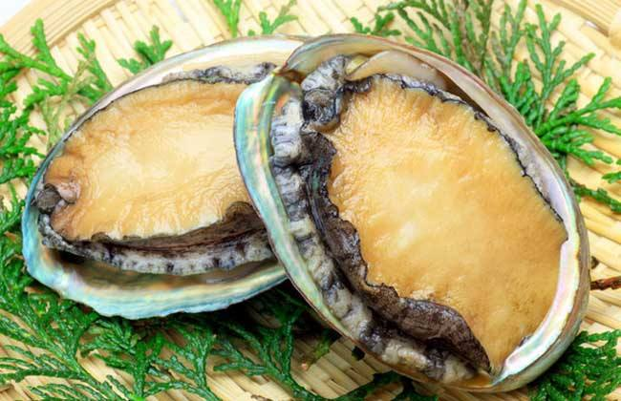


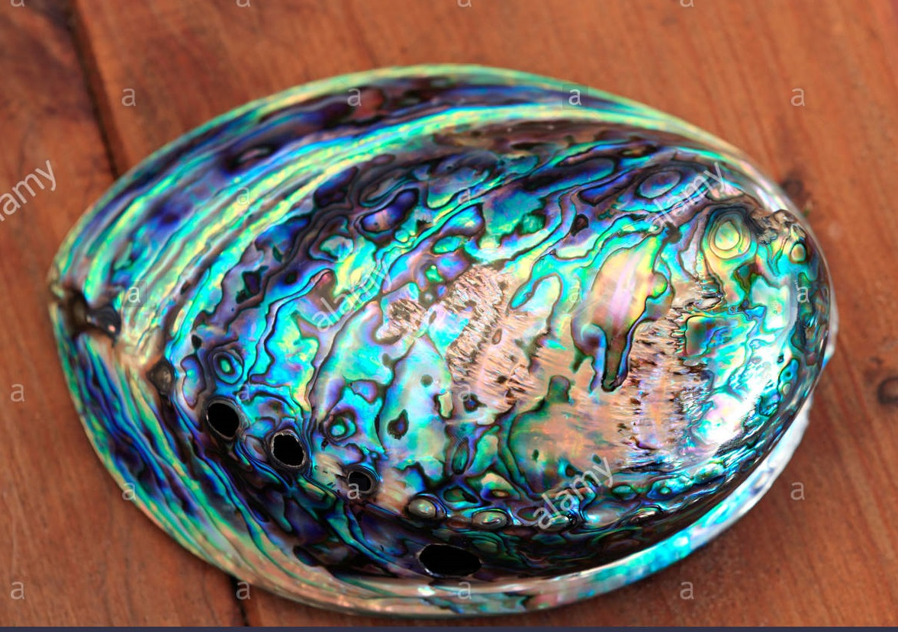
Cont’d

Slide 5
Abstract
In machine learning, classification is a supervised learning concept which basically categorizes a set of data in to classes.
The system involves applying preprocessing techniques to the abalone datasets.
The system develops a model by using classification based random forest.
The system accepts the values of attributes which are used to determine age of abalone.
The system purposes very simple ways to reduce the cost of producers as well as abalone farming.

Slide 6
Objectives
To implement the Abalone Classification system using random forest
To improve abalone data from original datasets with data visualization
To study the concept random forest with python programming language
To indicate the age of abalone (young, adult, old)
To help the abalone farming and producers which the production of luxury items

Slide 7
Scope of Thesis
Preprocess the Abalone Dataset with feature engineering
Classify the age of abalone based on users’ inputs
Apply Random Forest algorithm to classify
Show the age of abalone by grouping (young ,adult, old)
Study the system with stream-lit framework python language

Slide 8
Theoretical Background
Data Preprocessing
Data Preprocessing is used to classical data mining tasks, as classification or regression.
Data Preprocessing is one of the most critical steps in data mining process which deals with the preparation and transformation of the initial dataset.
The major steps involved in Data Preprocessing , namely, data cleaning, data integration, data reduction, and data transformation.

Slide 9
Cont’d
Data Cleaning
It can handle two types: missing value, noisy data
In Noisy data, the Mahalanobis distance is a scale-irrelevant distance between two data samples.
The outlier can be decided by comparing the Mahalanobis distance between each sample and the mean value of all samples.

Slide 10
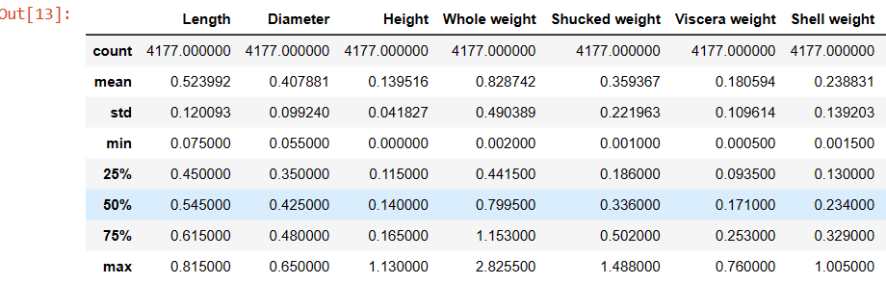
Cont’d

Slide 11
Cont’d
Data Integration
Redundancy and Correlation Analysis: Redundancy is another important issue in data integration.
Some redundancies can be detected by correlation analysis.
We can use the correlation coefficient and covariance, both of which access how one attribute’s values vary with those of another.

Slide 12
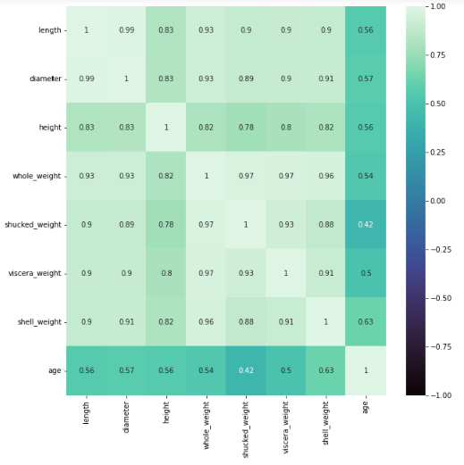
Cont’d

Slide 13
Cont’d
Data Reduction
The technique helps to reduce the amount or dimension, or both, of a dataset
Feature selection is about removing irrelevant or correlated attributes from the dataset
Feature selection methods use Filter types.
Filter directly select the feature based on attribute level criteria, including information gain, correlation score.

Slide 14
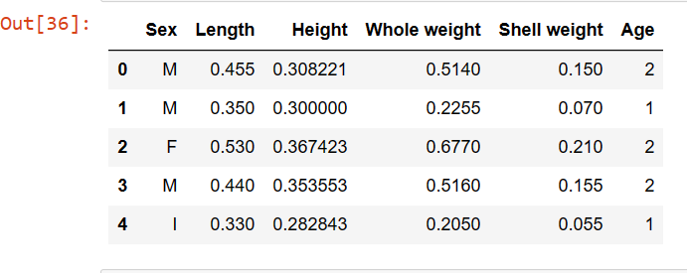
Cont’d

Slide 15
Cont’d
Data Transformation
Data transformation is about modifying the representation of data.
Categorical data is supposed to be encoded into numerical data, making it meets the requirements of the models.
Encoding techniques are adopted for numeralization.
One-Hot encoding: Regard each possible value of the categorical data as a single dimension, and use 1 for the dimension which the sample belongs to the category, otherwise 0.

Slide 16
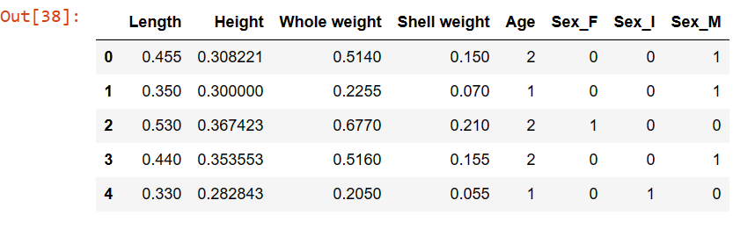
Cont’d

Slide 17
Cont’d
Random forest
Random forest is a supervised learning algorithm. It can be used both for classification and regression.
Random forest creates decision trees on randomly selected data samples, gets prediction from each tree and selects the best solution by means of voting.
It also provides a pretty good indicator of the feature importance.

Slide 18
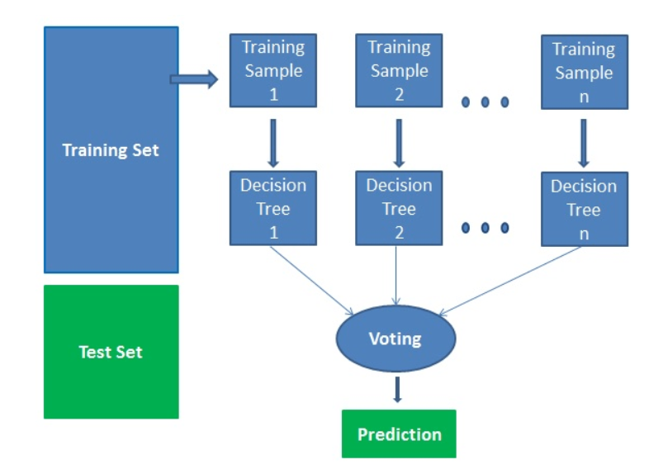
Cont’d

Slide 19
Cont’d
Random forest works in four steps:
Select random (bootstrap) samples from a given dataset.
Construct a decision tree for each sample and get a prediction result from each decision tree.
Perform a vote for each predicted result.
Select the prediction result with the most votes as the final prediction..

Slide 20

Cont’d
Random Forest Classification Algorithm
1. For b = 1 to B:
(a)Draw a bootstrap sample $Z^{∗}$of size N from the training data.
(b)Grow a random-forest tree $T_{b}$to the bootstrapped data, by recursively repeating the following steps for each terminal node of the tree, until the minimum node size $n_{min}$is reached.
i. Select m variables at random from the p variables.
ii. Pick the best variable/split-point among the m.
iii. Split the node into two daughter nodes.
2. Output the ensemble of trees ${\{T_{b}\}}_{1}^{B}.$

Slide 21

Cont’d
Classification;
Let $C_{b}(x)$ be the class prediction of the $b^{th}$random-forest tree.
$C_{rf}^{B}$(x) be the final result of random-forest . Then
$C_{rf}^{B}$(x) = majority vote {${C_{b}(x)\}}_{1}^{B}$ .
For classification, the minimum node size is one.
For regression, the minimum node size is three or four.

Slide 22
Cont’d
What is Bootstrap Aggregating?
Bootstrap aggregating is also called bagging.
We train a number of decision trees from bootstrap samples of your training set.
Bootstrap sampling means drawing random samples from our training set.
For classification, a committee of trees cast a vote for the predicted class.

Slide 23
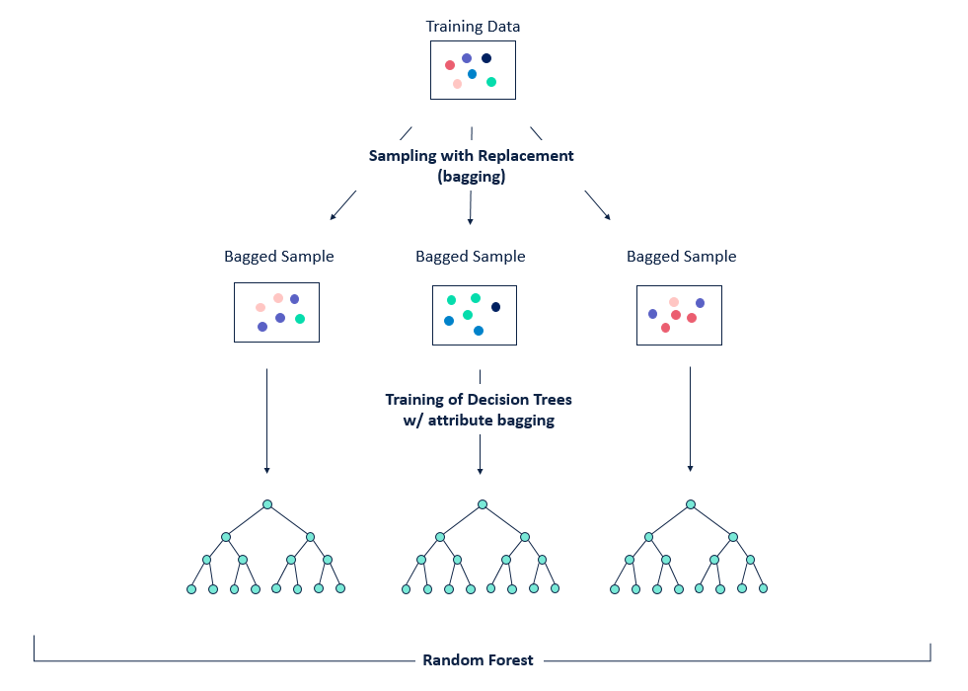
Cont’d

Slide 24
Cont’d
What is a Decision Tree?
Decision tree is a simple, deterministic data structure for modelling decision rules for a specific classification problem.
At each node, one feature is selected to make separating decision.
We can stop splitting once the leaf node has optimally less data points.
Such leaf node then gives us insight into the final result.
One popular method for splitting is Gini Impurity.

Slide 25
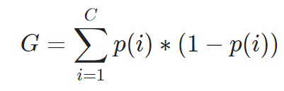
Cont’d
What is a Gini Impurity?
Gini Impurity is the probability of incorrectly classifying a randomly chosen element in the dataset if it were randomly labeled according to the class distribution in the database. It’s calculated as
where ,C is the number of class
p(i) is the probability of randomly picking an element of class i.

Slide 26
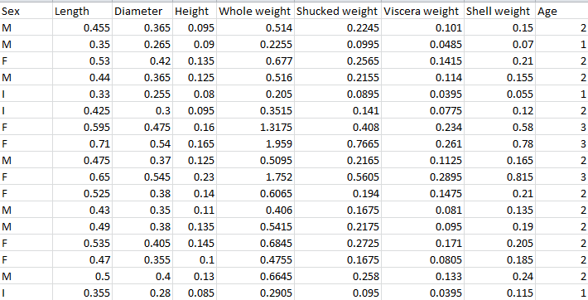
Dataset

Slide 27
Cont’d
Dataset Attributes:
Sex (Male,Female,Infant)
Length
Diameter
Height
Whole weight (whole abalone)
Shucked weight (weight of meat)
Viscera weight (weight after polishing)
Shell weight (weight after being dried)
Age(Target Class)

Slide 28
Cont’d
Featured columns
Age
Number of rows
9 columns
Age ( young, adult, old )
4178 rows

Slide 29
System Design
Training Stage
Testing Stage
Start
Start
Abalone Dataset
Abalone
data
Preprocessing
Stored DB
Classify using Random Forest
Train Dataset using Random Forest
The age of Abalone
Trained Model
End
End

Slide 30
Output
The system can be used to reduce the cost for production of adornment items and know how abalone is growing within duration.
The age of abalones can be classified without the laboratory experiments.
The age of abalones can be determined by using the very simple physical characteristics like weight, height and length .

Slide 31
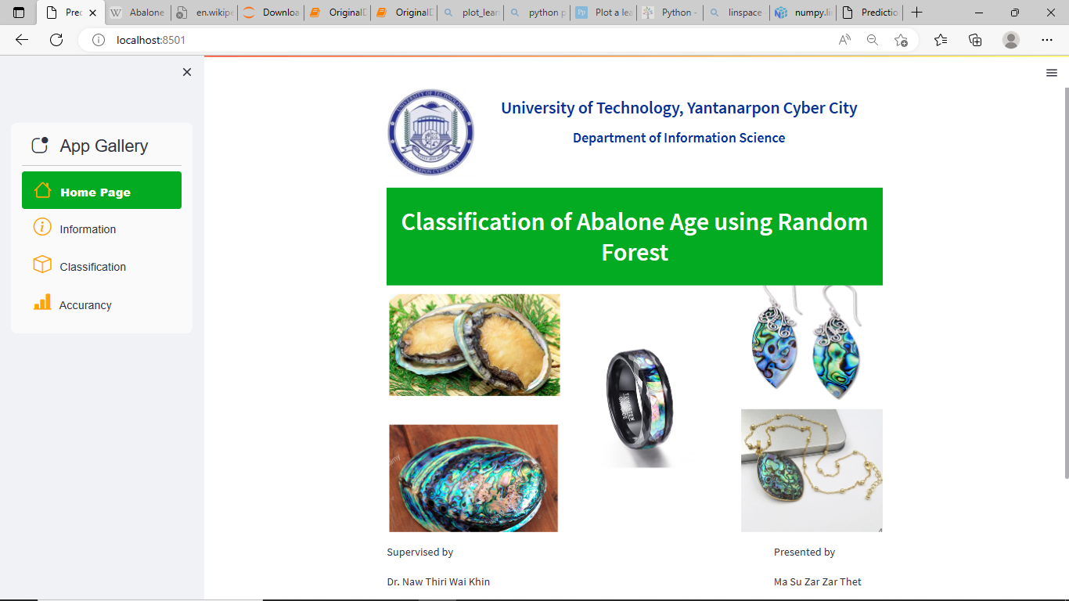
Implementations
Figure 1.1 Home Page

Slide 32
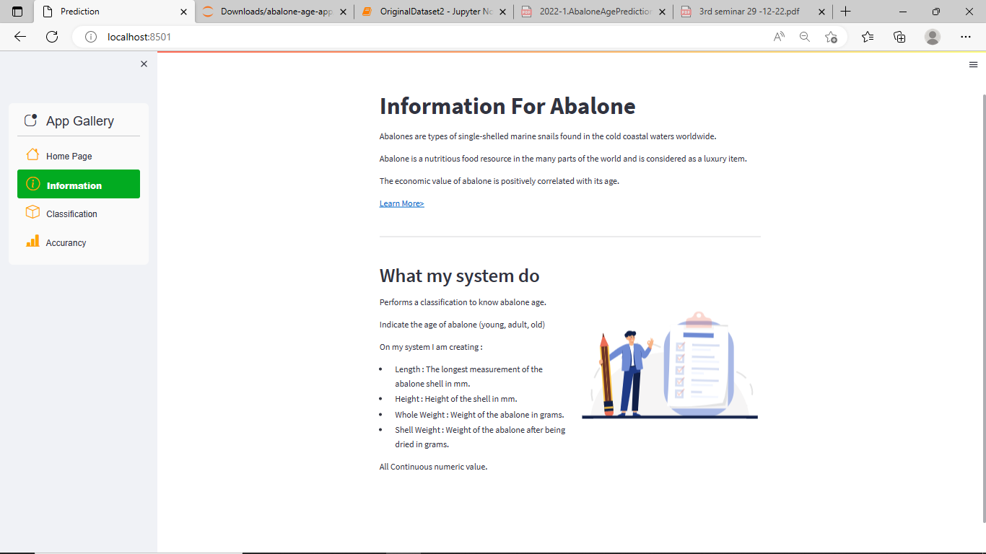
Cont’d
Figure 1.2 Information Page

Slide 33
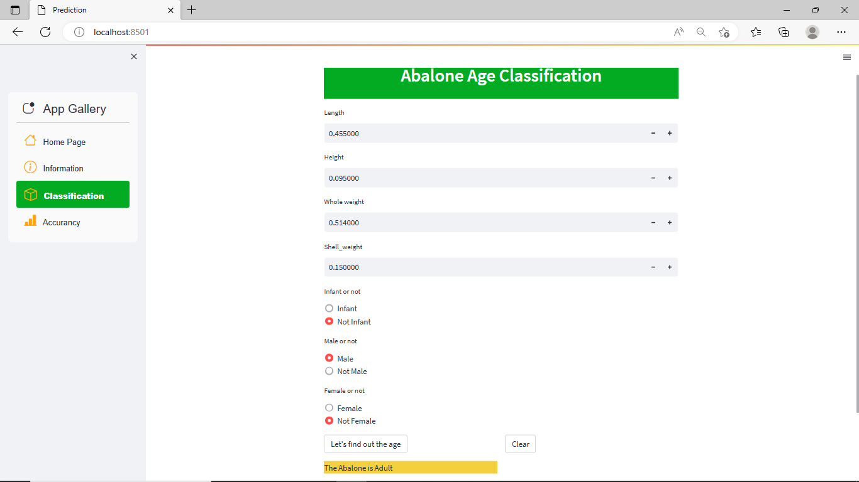
Cont’d
Figure 1.3 Classification Page

Slide 34
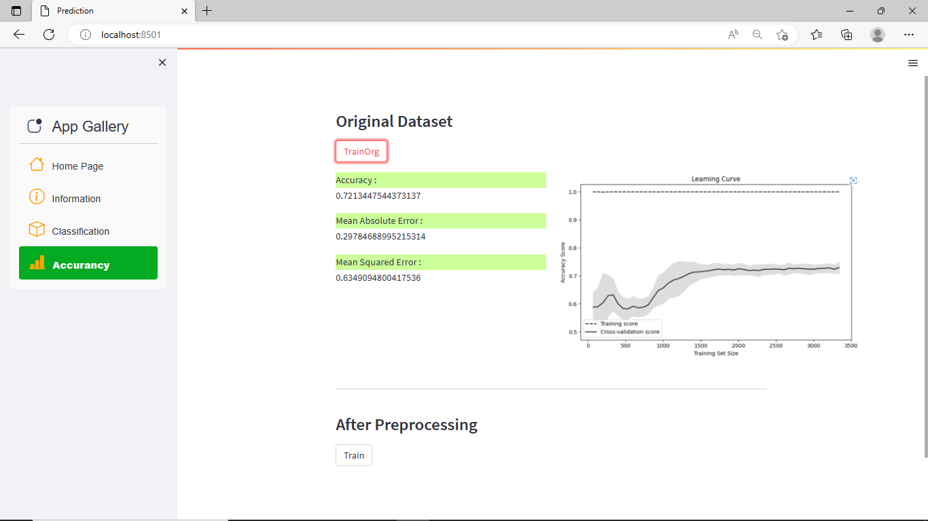
Cont’d
Figure 1.4 Accuracy for Original Dataset Page

Slide 35
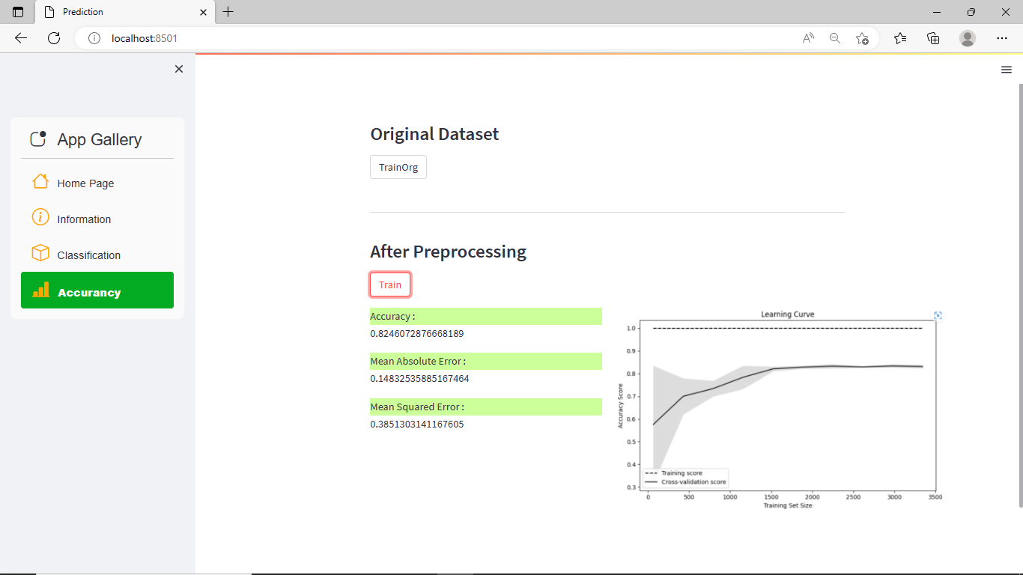
Cont’d
Figure 1.4 Accuracy for Preprocessing Dataset Page

Slide 36
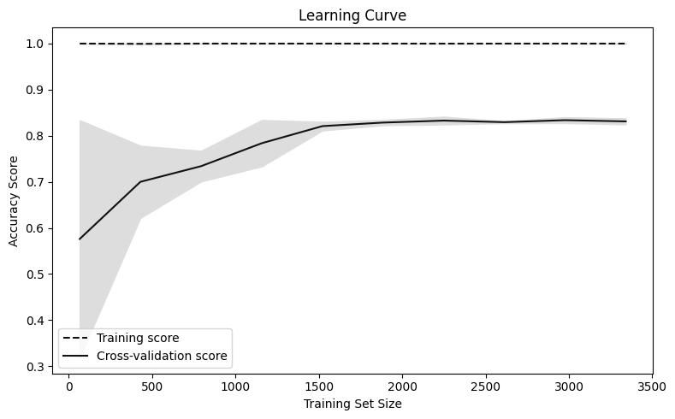
Experimental Result
Data Point: Training shape-3340, Testing shape-835 ;80/20
Mean Absolute Error : 0.16028708133971292
Mean Squared Error : 0.4033353763771789

Slide 37
Conclusion
Abalone dataset is preprocessed using feature engineering and visualization.
Abalone age classification system will be implemented using Random Forest.
The age of abalone will be classified according to their physical characteristics.
A graph will be provided to show the comparison between original dataset and pre-processing dataset.

Slide 38
Future Work
The system can be implemented by using other classification method.
The system can be extended by employing an automatic feature extraction step from images of the abalone for its age prediction.
The system can be extend by using in web application.
The prices of abalone can be displayed according to their age.

Slide 39


